Slide 1


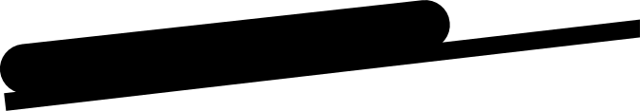



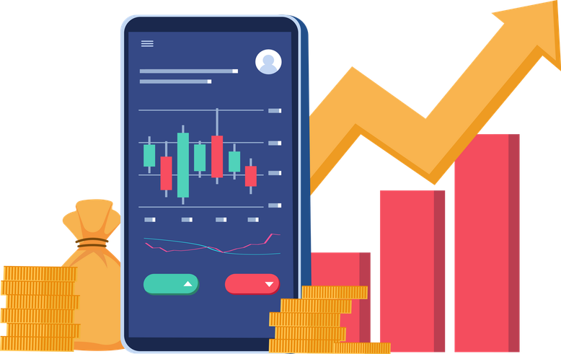
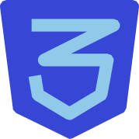
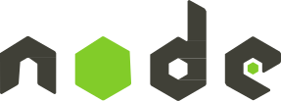


Phase 2
MERN Stack PROJECT:
Zerodha Trading APP
Development Phase
Java & Web Application Development
By Zubair Khan
Matriculation: 92127983
BSC in Computer Science
Github Repository: https://github.com/zbr-khn/Zerodha_IU_WebApp

Slide 2

Purpose of the App
The app is designed to give a responsive trading experience in real time,
using the MERN stack to simulate the environment of a professional online trader. It is ideal for anyone who wants to analyze the market, follow their investments and use a smooth and secure web-based trading platform.

Slide 3
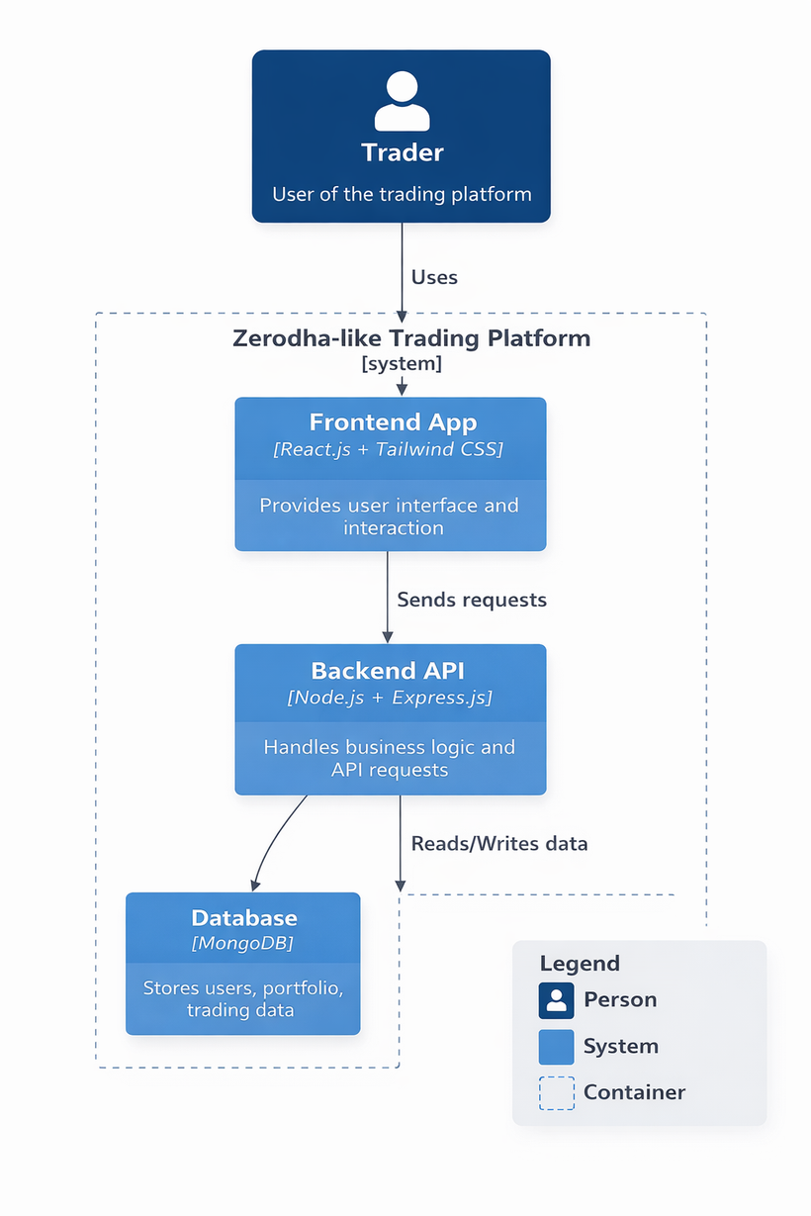


Architecture Diagram
C4 Model

Slide 4




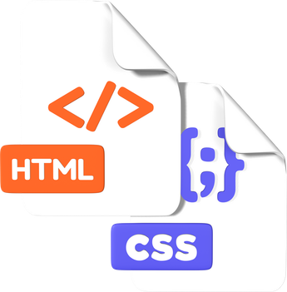

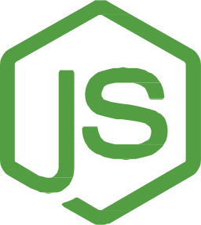

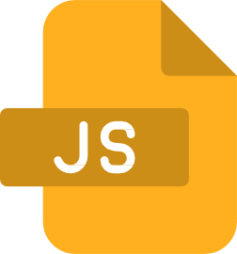
Technology Used
Frontend
React.js (v19.1.0) – Core library for building dynamic UIs React-Router-Dom (v7.5.3) – Handles client-side navigation Material UI & Emotion – For styled components and UI icons Chart.js & React-Chartjs-2 – Enables interactive visual data representation
Axios (v1.6.7) – For API communication with backend services
Web-Vitals – Measures and tracks app performance Testing Libraries – Integrated with Jest-DOM, User-Event, and React Testing Library for robust frontend testing
Backend (API & Authentication)
Node.js & Express.js (v5.1.0) – Build and serve RESTful APIs MongoDB & Mongoose (v8.14.1) – For schema-based NoSQL database operations
Passport.js & Passport-Local-Mongoose – Implements secure user authentication
Dotenv – Manages sensitive config via environment variables
CORS & Body-Parser – Middleware for secure and structured request handling
Nodemon – For live development and reloading
Dashboard:
Enhanced with MUI, Chart.js, and React Chart components
Custom insights with visual analytics for portfolios and trading metrics

Slide 5
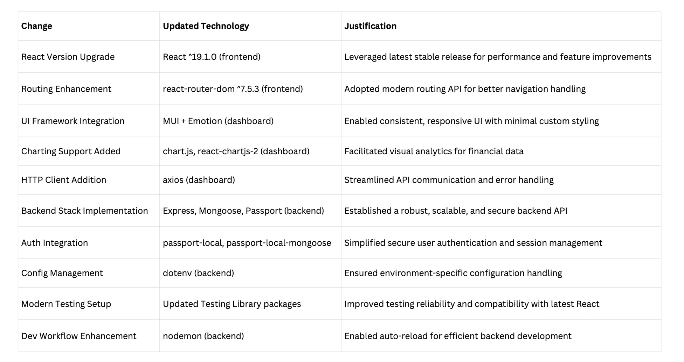
Changes from the Original Proposal and Reasons

Slide 6

Benefits & Features
Smooth and user-friendly trading experience that fits any level of investors. Real time market information to trade efficiently and intelligently.
Deep technical analysis advanced charting.
Easy and fast order entry to execute trade efficiently. Holding and P&L portfolio monitoring with a detailed view.
The availability of detailed reports on the history of performance and trading.
It has fund management functionality that allows easy deposits and withdrawals. Price movement and trade alerts and notifications.
Kite and Console are examples of integrated tools for increased functionality and analytics. One-stop shop to help you invest intelligently and wisely.

Slide 7
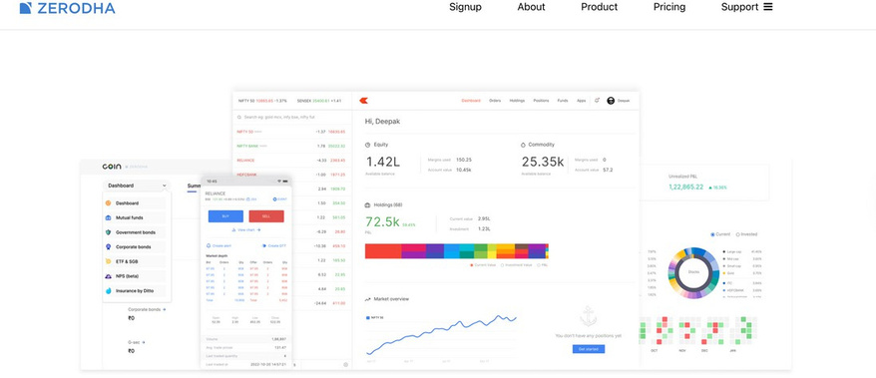
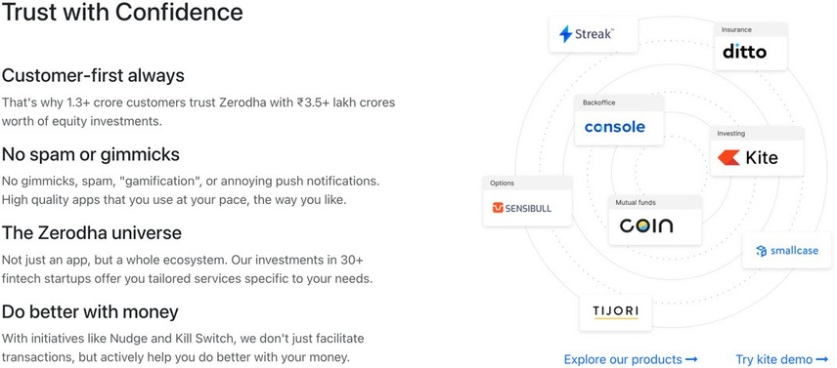
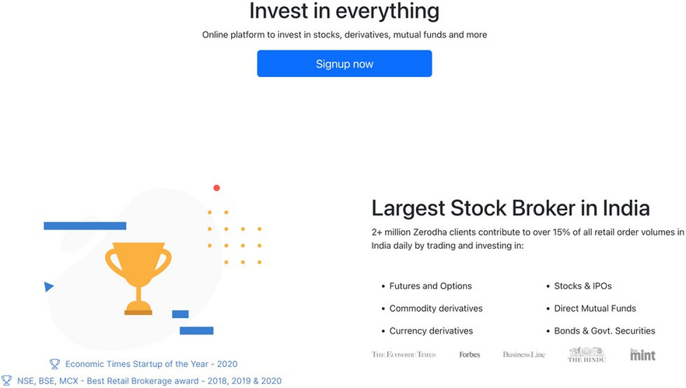
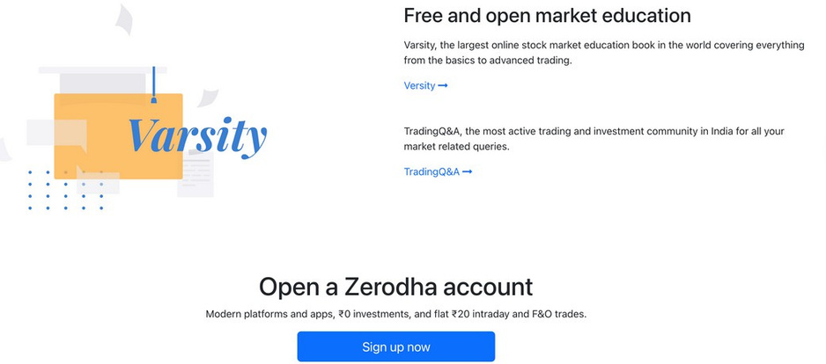
Home Page
The homepage of Zerodha features the secure, user-first investment platform, which provides a wide variety of financial products, educational resources such as Varsity, and transparent services, which motivate people to invest and learn with ease.

Slide 8
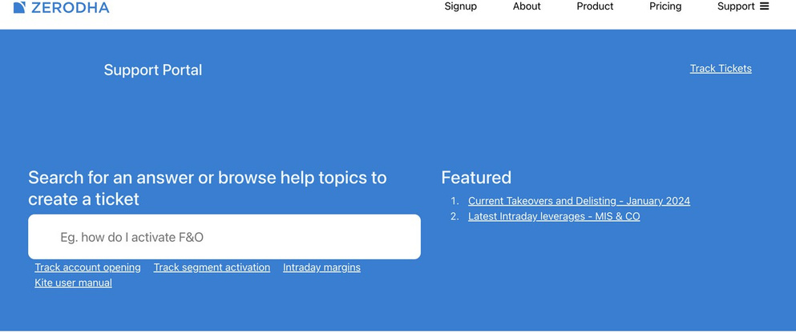
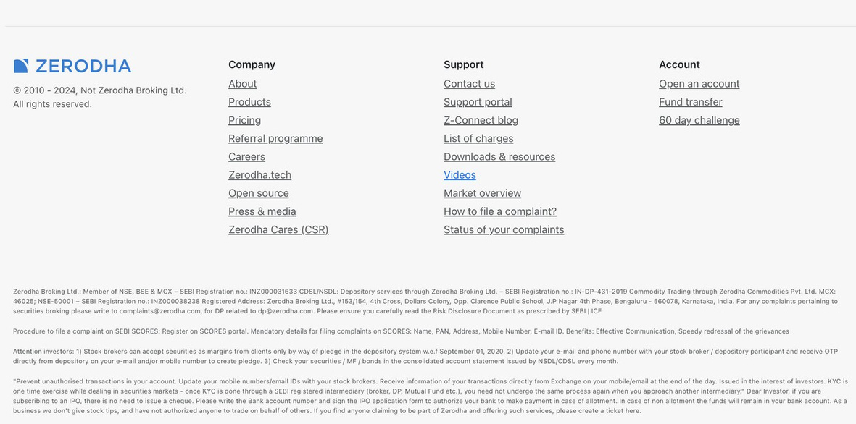
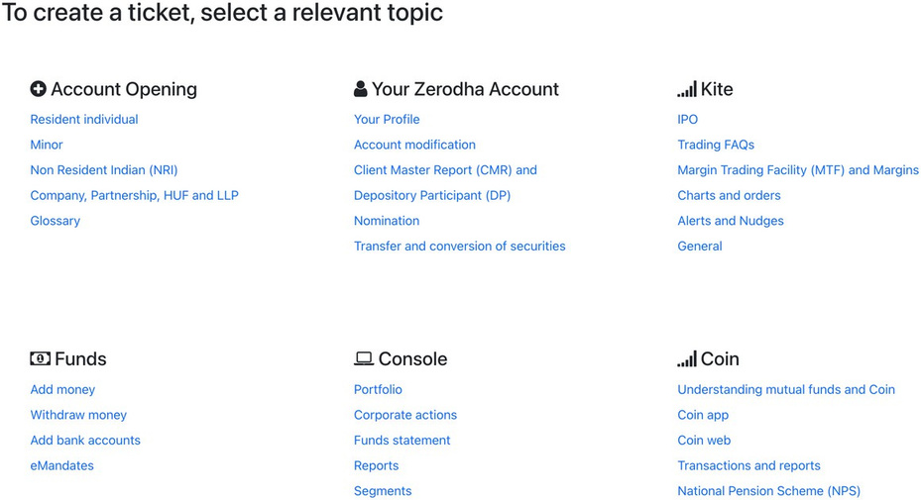
Support Portal
Zerodha support portal provides a focal point of user help-it provides help topics, creation of tickets, and support categorized to speed up an issue.

Slide 9
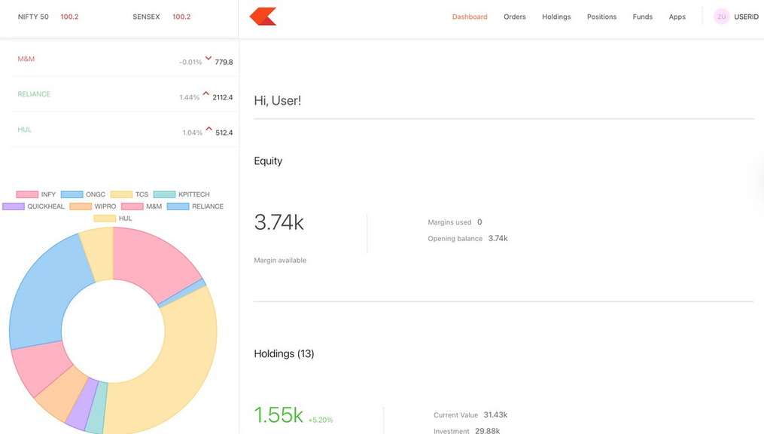
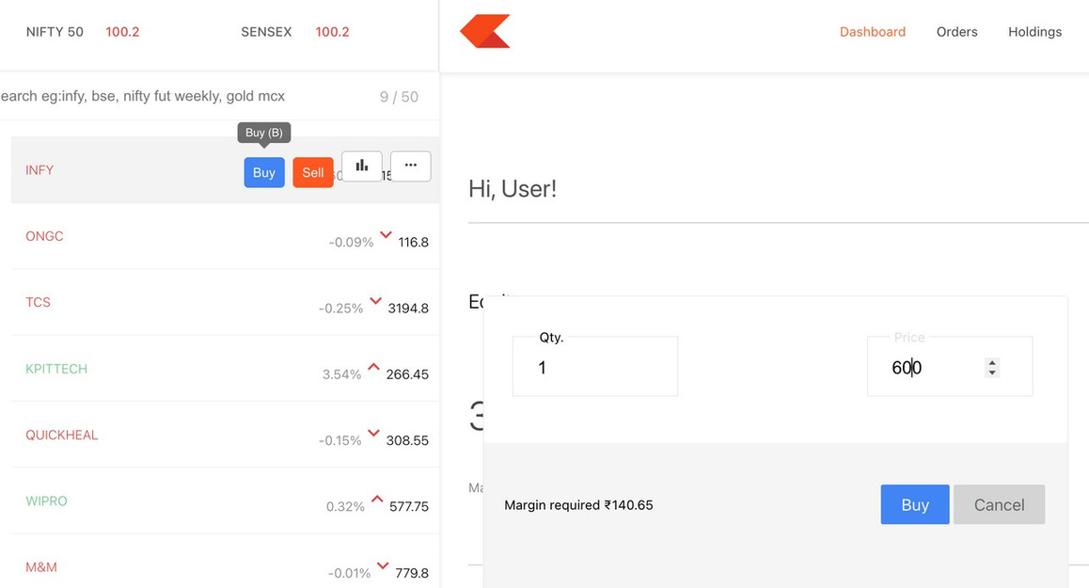
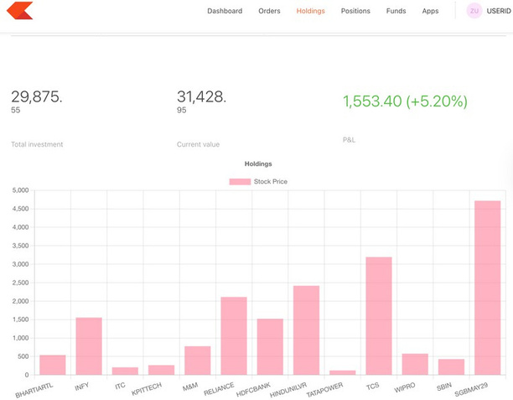
Dashboard
The dashboard provided by Zerodha gives a real-time and complete view of the trading portfolio of the user. The interface shows major data including equity, holdings and profit/loss overviews, as well as easy to understand visual charts, such as pie and bar graphs. The dashboard will allow users to monitor their stocks and see market indices and also make trades. It facilitates fast accessibility to orders, positions and funds, which guarantees a smooth portfolio tracking and trading decisions.

Slide 10

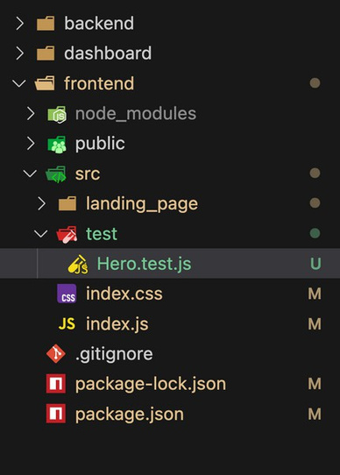
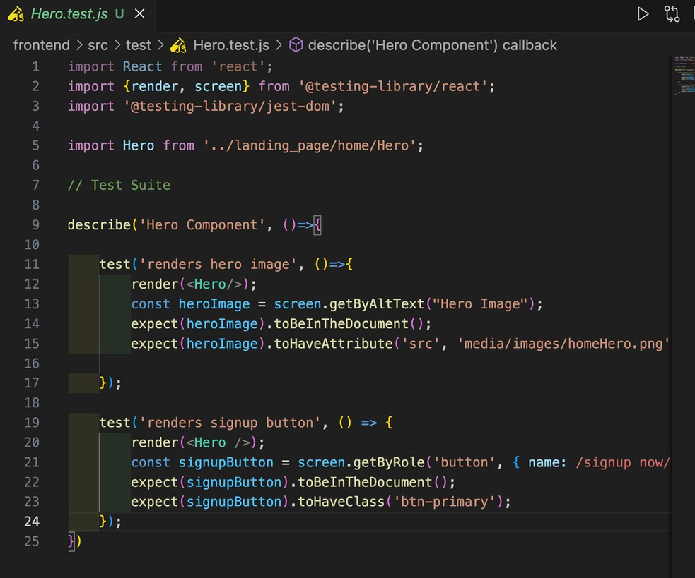
Test Case 1
In case of the Zerodha Trading App, the component testing was applied with the help of Jest and React Testing Library to make sure that the major UI elements appear and work as intended.
Emphasis was put on the Hero part of the landing page.
Two large tests were developed:
Image Rendering Test: This tests that the Hero image is loaded properly with use of alt text, and that the image source attribute indicates the expected file path.
Signup Button Test: This guarantees that the signup button is visible and serves its purpose. It also confirms that the appropriate styling class (btn-primary) is present, guaranteeing a consistent look and ease of use.
The tests make the UI more reliable and contribute to the early detection of regressions during development.

Slide 11
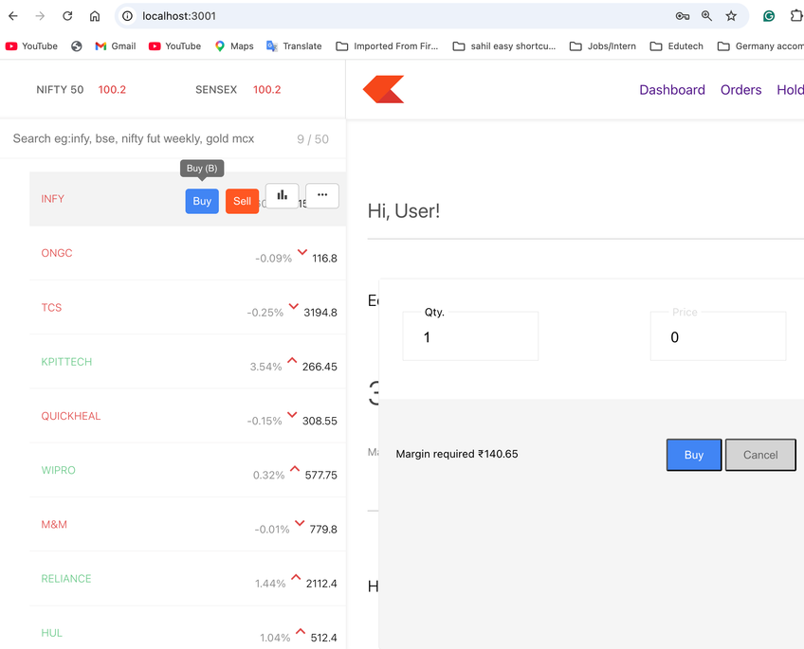
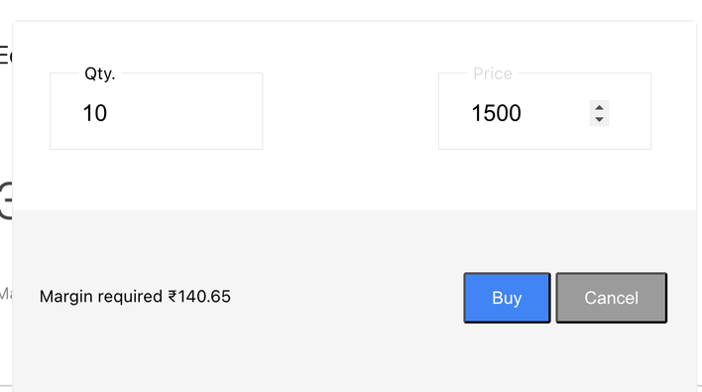
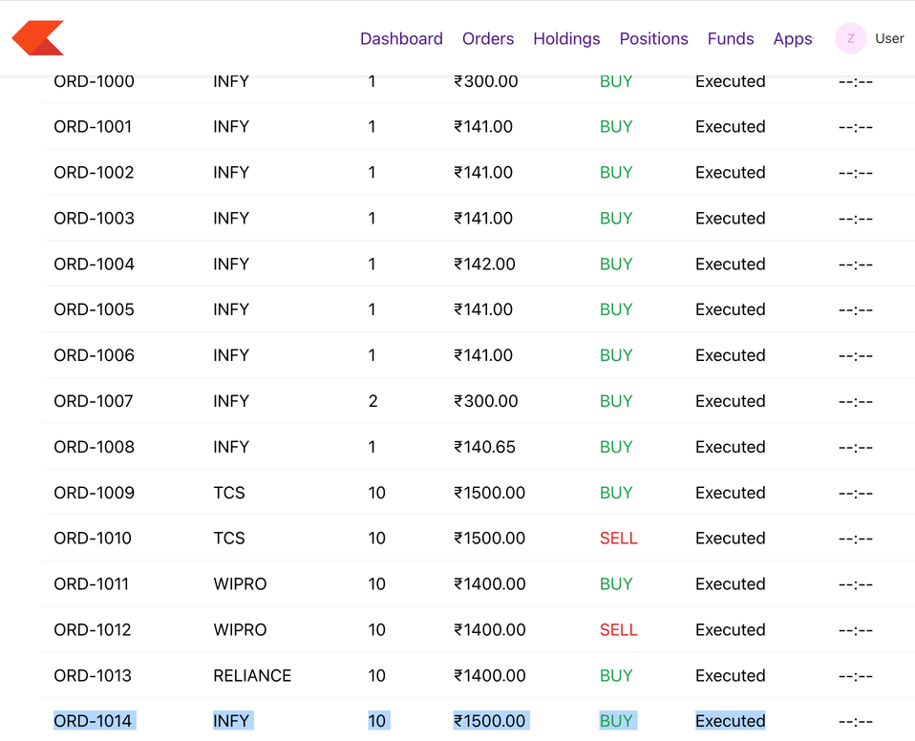
Test Case 2
When I buy any new stock, for example
Quantity 10, Price: 1400 then it is coming in the orders section.
Step 1:
Step 2:
Step 3:

Slide 12
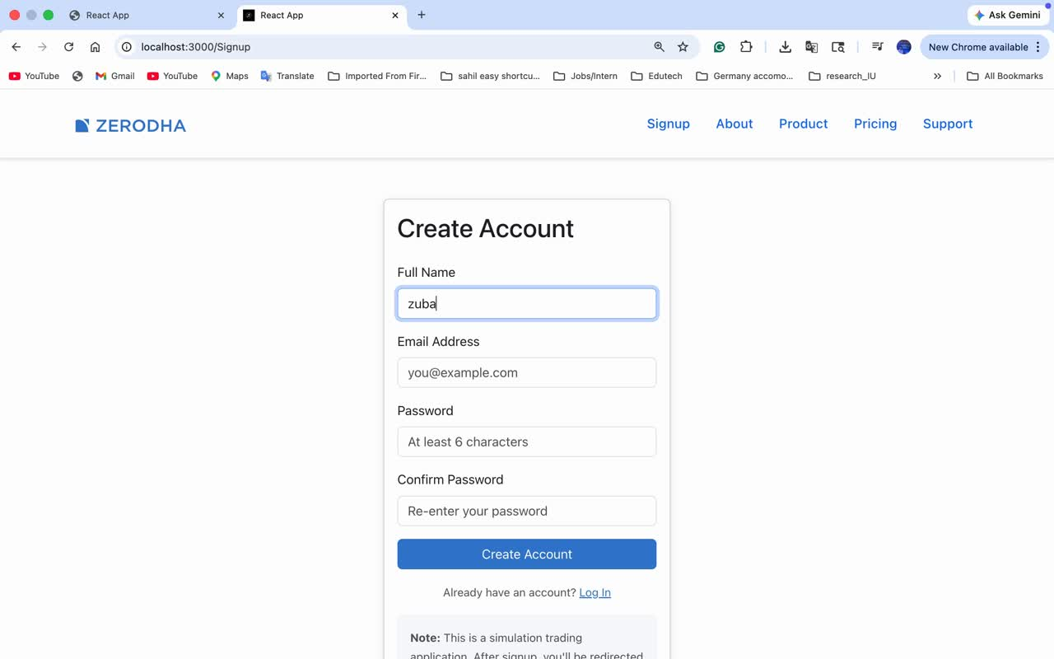
Screencast Video

Slide 13

Summary
The Zerodha-like Trading Application is a full-stack web-based platform developed using the MERN stack (MongoDB, Express.js, React.js, and Node.js) to simulate a real-world online trading environment. The application is designed to provide users with a responsive, secure, and user-friendly interface for analyzing financial markets, managing investments, and executing trades efficiently.
It follows a layered architecture where the React-based frontend handles user interaction and visualization, the Node.js and Express backend manages business logic and API communication, and MongoDB stores user data, portfolios, and transaction records. The platform includes key features such as real-time portfolio tracking, advanced charting for technical analysis, fast order execution, profit and loss monitoring, and detailed performance reports.
Additionally, it offers fund management capabilities, price alerts, and integrated tools for enhanced analytics. The user interface is divided into essential modules, including a homepage for onboarding and education, a dashboard for real-time portfolio insights with graphical representations, and a support portal for user assistance and issue resolution. The application also incorporates testing using Jest and React Testing Library to ensure reliability and proper functionality of UI components and trading operations.
Overall, this project demonstrates a realistic and scalable trading system, combining modern web technologies, clean architecture, and practical financial features, making it a strong representation of a professional trading platform suitable for both academic and portfolio purposes.

